Slide 1
WEEKLY PROGRESS · WEEK 3
Building the UF3 model
Marios Poulis
Monday 21 September 2026
Notes:
Hi Daniel. Last week was the SuperSalt reproduction — that baseline is validated and locked in. This week I moved onto our own model: first I made sure I actually understand UF3, then I built the 2-body version of it from scratch and got real numbers on both test sets. Let me walk you through the method, then the model I built, then the results.

Slide 2
AGENDA
This week
01
What UF3 actually is
The many-body expansion, flexible splines, a linear fit
02
The 2-body term and 3-body term
A learned pair potential — what it captures and what it can't
03
The pipeline I built
Five steps from structures to a working ASE calculator
04
Results & next steps
2-body accuracy on both test sets, and where it goes
Marios Poulis · DIFFER
2
Notes:
Plan for today: what UF3 is under the hood, then the 2-body term specifically, then the pipeline I built to train it, and finally the accuracy I'm getting and what I want to do next.

Slide 3
THE METHOD
What UF3 is
A force field written as a sum of simple interaction terms, each a flexible curve fit to DFT data.
E ≈ Σ E₁ + ½ Σ V₂(r) + ⅙ Σ V₃(triangle)
one-body offsets + pairs (built this week) + triangles (a later extension)
Flexible curves
A linear fit
“Ultra-fast”
Each term is a cubic B-spline — a smooth curve made of local bumps — not a fixed formula. It bends to fit whatever the DFT data shows.
Energy is linear in the spline coefficients, so training is one regularized least-squares solve — no iterative neural-network training.
That linear form is the whole point: fitting is seconds, and evaluating the potential in MD is far cheaper than a neural network.
Marios Poulis · DIFFER
3
Notes:
The core idea: instead of one big neural network, UF3 writes the energy as a sum of simple pieces — a per-element offset, a pair term for every two atoms, and in principle a three-body term for triangles. Each piece is a flexible spline curve fit to the DFT data. Because energy is linear in those spline coefficients, training is just a regularized least-squares solve — that's why it's fast to fit and cheap to run. This week I built the pair term; the triangle term is a later extension.

Slide 4
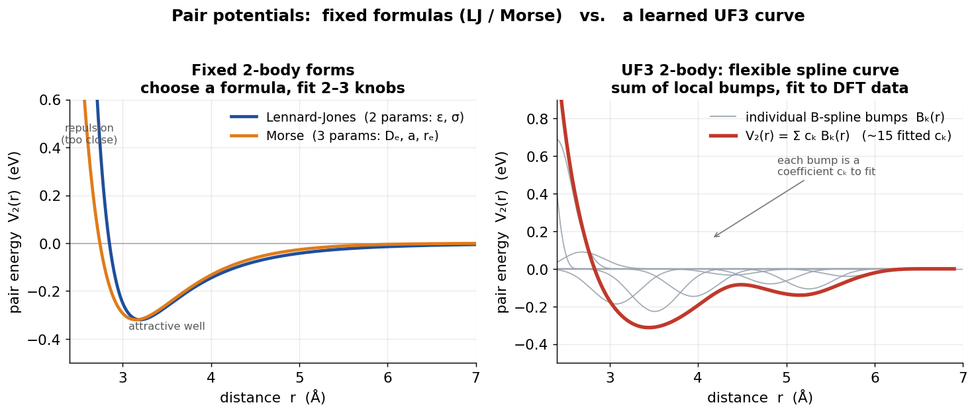
THE BUILDING BLOCK
The 2-body term: a learned pair potential
Reading the curve V₂(r)
Repulsive wall — how close two atoms can get (their size).
Minimum position — the preferred bond length.
Well depth — how strong the bond is.
Curvature — the stiffness of the bond.
Left: fixed formulas (Lennard-Jones, Morse) have 2–3 knobs. Right: UF3's pair term is a spline — ~15 coefficients — so it can take a shape the fixed forms can't.
It depends only on distance — so it captures how far, never at what angle.
Marios Poulis · DIFFER
4
Notes:
The pair term is a potential-energy curve as a function of distance between two atoms. Lennard-Jones and Morse are the classic fixed-formula versions with a couple of parameters; UF3 replaces the formula with a spline of about fifteen coefficients, so it can take a shape the fixed forms can't. You read it left to right: the steep wall is atomic size, the dip is the bond length, its depth is bond strength, its sharpness is stiffness. The key limitation to keep in mind: it only sees distance, never angle — that matters for the results.

Slide 5
FROM STRUCTURES TO A CALCULATOR
The pipeline I built
1
Define the system
List the 12 elements; ask for the 2-body pairs
the fit — one solve, not a training loop
cs = ChemicalSystem(elements, degree=2)
basis = BSplineBasis(cs, r_min, r_max, res)
X = featurize(frames)
model = WeightedLinearModel(basis, reg)
model.fit(x_e, y_e, x_f, y_f, weight=0.3)
calc = UFCalculator(model)
2
Build the basis
A B-spline per pair over r = 1.0–6.0 Å → 1,416 coefficients
3
Featurize
Turn every structure + force into rows of spline values
4
Fit
One regularized least-squares solve for all coefficients
5
Wrap as a calculator
Same ASE-calculator interface as MACE — so the exact evaluation loop from the reproduction scores UF3 with no changes.
A UF3 ASE calculator — drop-in, like the MACE one
Marios Poulis · DIFFER
5
Notes:
The pipeline is five steps. Define the system and get the list of element pairs; build a B-spline basis for each pair, which comes out to 1,416 coefficients; featurize every structure and force into rows of spline values; fit all the coefficients in a single regularized least-squares solve — no iterative training; and wrap the result as an ASE calculator. Because it's the same calculator interface as MACE, the exact scoring loop from last week's reproduction works on UF3 unchanged.

Slide 6
RESULTS
First working model: the 2-body numbers
Trained on a representative sample of the SuperSalt training set; scored on a fixed 660 / 160-frame slice of each held-out test set.
ENERGY MAE · BOTH TESTS
13–15 meV/atom
the surface itself is roughly right
FORCE RMSE · BOTH TESTS
278–302 meV/Å
the slope — where a pair term is limited
STATUS
It runs, end-to-end
our own model, real numbers, both sets
Marios Poulis · DIFFER
6
Notes:
Here's the first working model, scored on a fixed larger slice of each test set so the numbers are stable and not sampling noise. Energies land around 13 to 15 meV per atom — the energy surface is roughly in the right place. Forces are about 280 to 300 meV per angstrom, which is well above MACE. That gap is expected and structural: a pair term only sees distances, so it can't reproduce the angular part of the forces in a liquid. I also found that adding more training data barely moved the force error — that tells me we're near the limit of what a pure pair description can do. So the honest read is: a real, end-to-end model that runs on both test sets, energies reasonable, forces the known weak point of a pair model.

Slide 7
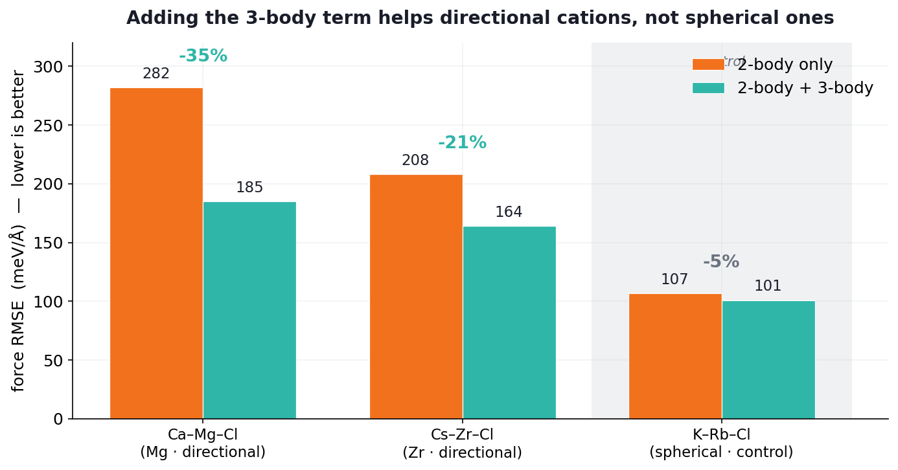
TESTING THE “3” IN UF3
Does the 3-body term earn its keep?
Full 3-body is intractable for 12 elements (111k features), so we test it on 3-element subsystems: directional cations (Mg, Zr) versus a spherical control (K, Rb).
What it shows
Directional cations. 3-body cuts the force error hard — Mg −35%, Zr −21%. The angular term captures the coordination geometry a pair potential can’t see.
Spherical control. K/Rb already had a low 2-body error and 3-body barely moves it (−5%) — round ions bond centrally, so there’s little angle to capture.
The gain tracks directionality — exactly where the physics predicts.
Marios Poulis · DIFFER
7
Notes:
Then I tested whether the 3-body term actually helps. Full 3-body on all twelve elements is intractable — 111 thousand features — so I tested it on three-element subsystems: two with a directional cation, Mg and Zr, and one spherical control with K and Rb. The result is clean: on the directional systems 3-body cuts the force error by 21 to 35 percent, but on the spherical control it barely moves, five percent, because those round ions were already well described by pairs. So the angular term earns its keep exactly where the physics says it should. Numbers are on small subsystems with a short 4-angstrom 3-body cutoff, so treat them as a proof of concept, but the pattern is unambiguous.

Slide 8
ROADMAP
Next steps
Firm up the 3-body subsystem result
Larger frame counts and a longer cutoff to confirm the 20–35% force gains on directional cations; add a third (Zn). Featurization is slow, so this runs off the laptop.
NOW
Score on the full test sets
Move from sampled to complete Test 1 / Test 2 evaluation, using the fast matrix-multiply scoring, for paper-comparable numbers.
NEXT
Marios Poulis · DIFFER
8
Notes:
Next: firm up the 3-body result with more data and a longer cutoff, and add another directional cation like Zn — the featurization is slow so I'm running that off the laptop. Then score on the full test sets with the fast matrix-multiply evaluation rather than the slow calculator loop. And then the apples-to-apples comparison against SuperSalt on identical frames, with a speed and cost figure — that's the real point of the project.

